Slide 1
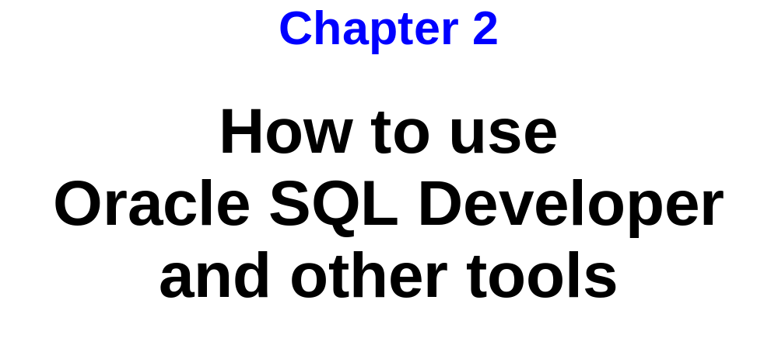
Murach’s Oracle SQL and PL/SQL, C2
© 2014, Mike Murach & Associates, Inc.
Slide <number>

Slide 2
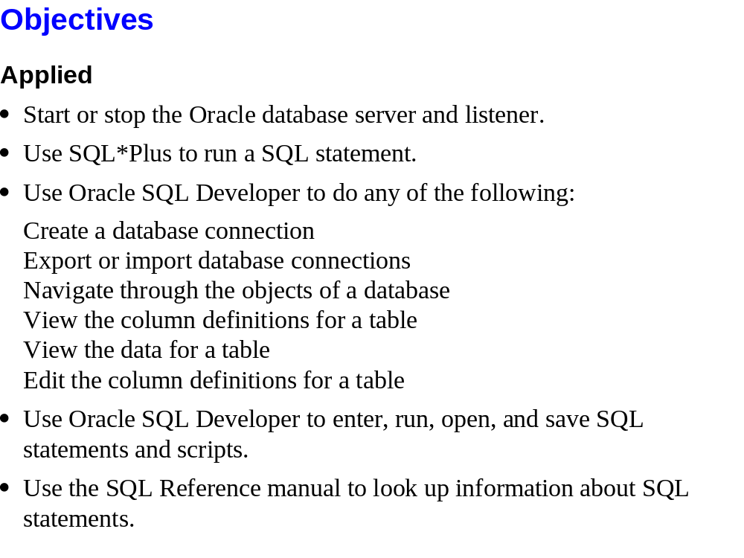
Murach’s Oracle SQL and PL/SQL, C2
© 2014, Mike Murach & Associates, Inc.
Slide <number>

Slide 3
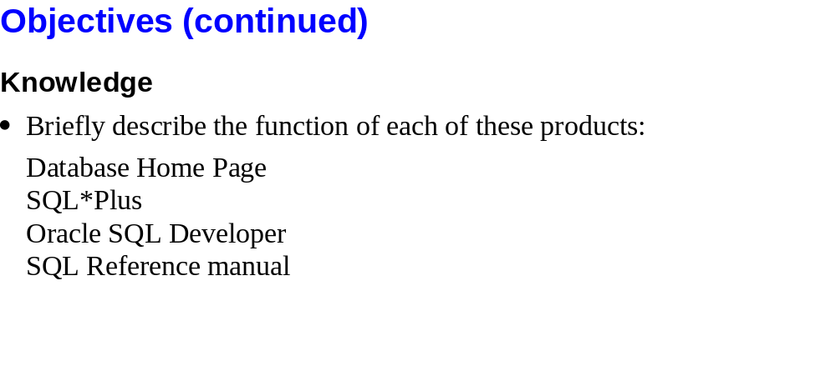
Murach’s Oracle SQL and PL/SQL, C2
© 2014, Mike Murach & Associates, Inc.
Slide <number>

Slide 4
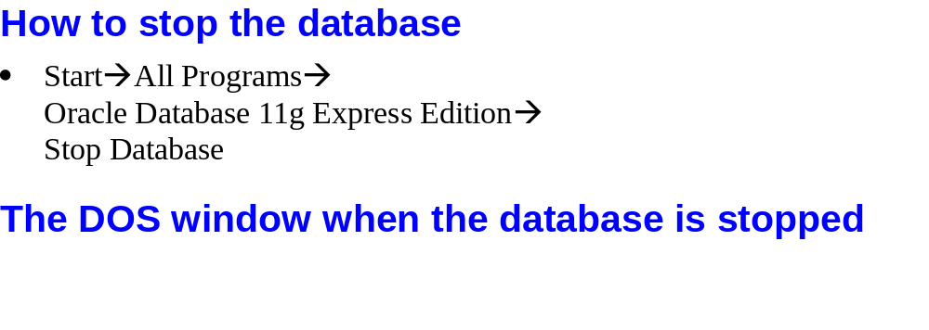
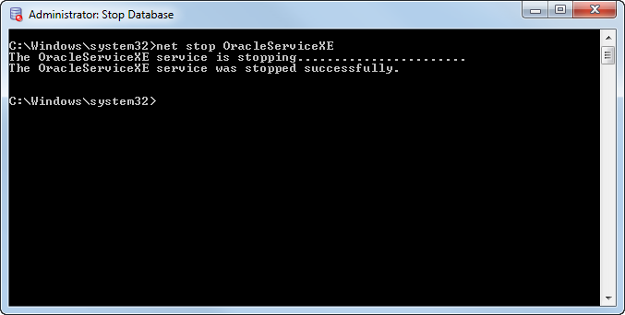
Murach’s Oracle SQL and PL/SQL, C2
© 2014, Mike Murach & Associates, Inc.
Slide <number>

Slide 5
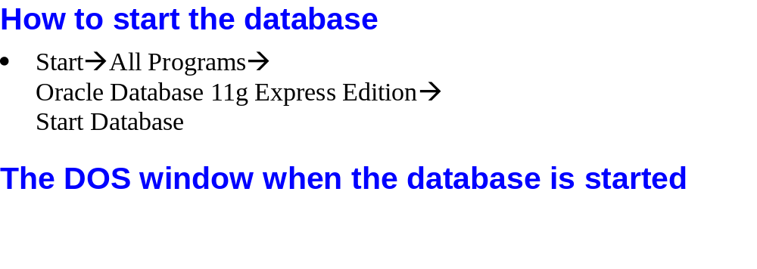
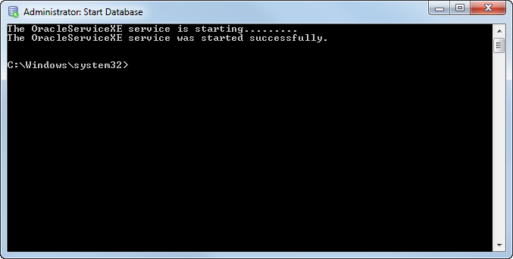
Murach’s Oracle SQL and PL/SQL, C2
© 2014, Mike Murach & Associates, Inc.
Slide <number>

Slide 6
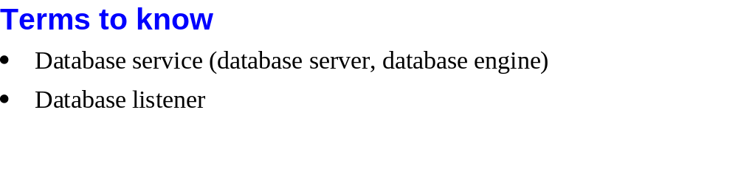
Murach’s Oracle SQL and PL/SQL, C2
© 2014, Mike Murach & Associates, Inc.
Slide <number>

Slide 7

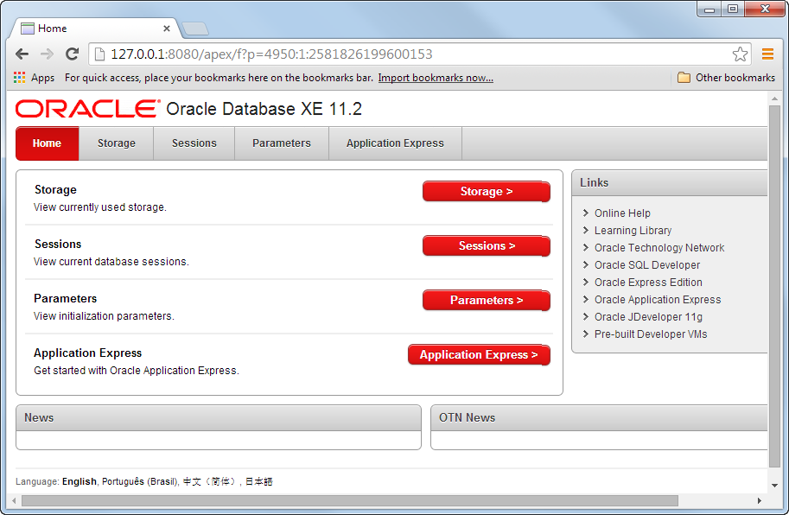
Murach’s Oracle SQL and PL/SQL, C2
© 2014, Mike Murach & Associates, Inc.
Slide <number>

Slide 8
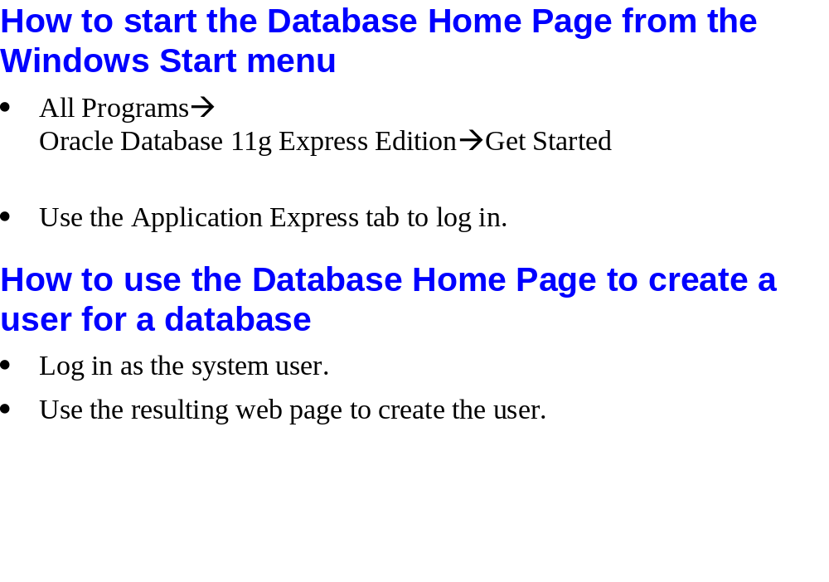
Murach’s Oracle SQL and PL/SQL, C2
© 2014, Mike Murach & Associates, Inc.
Slide <number>

Slide 9

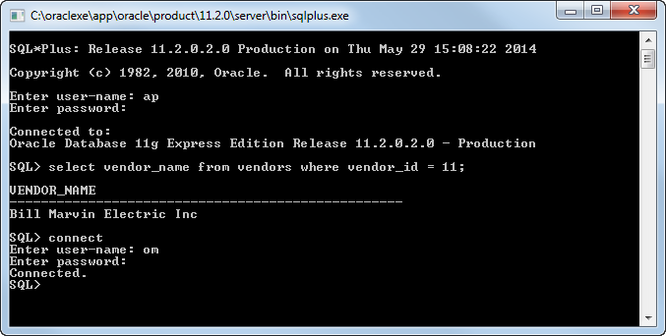
Murach’s Oracle SQL and PL/SQL, C2
© 2014, Mike Murach & Associates, Inc.
Slide <number>

Slide 10
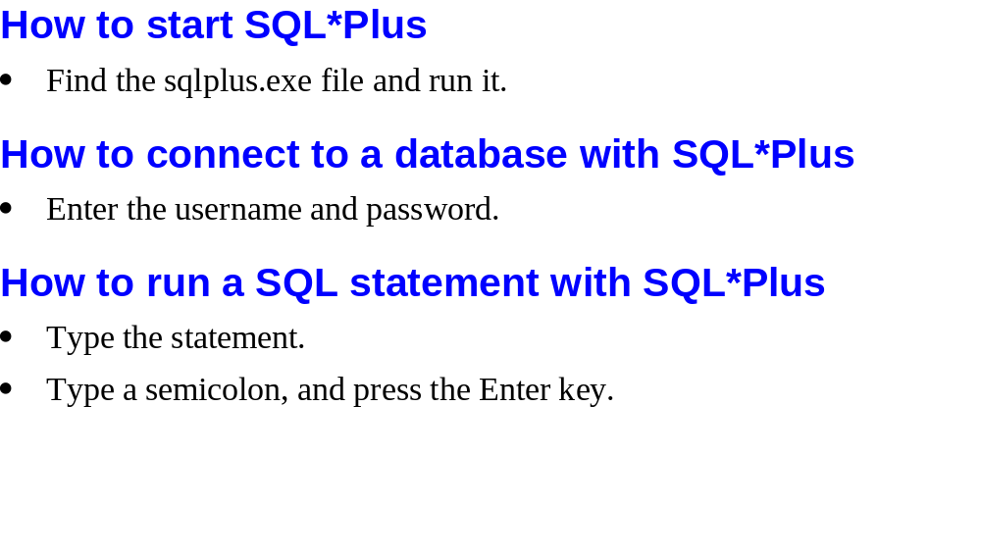
Murach’s Oracle SQL and PL/SQL, C2
© 2014, Mike Murach & Associates, Inc.
Slide <number>

Slide 11
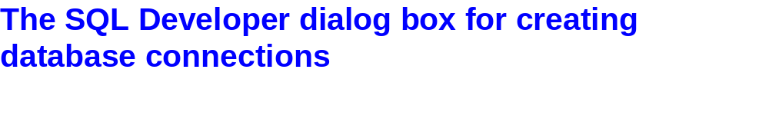
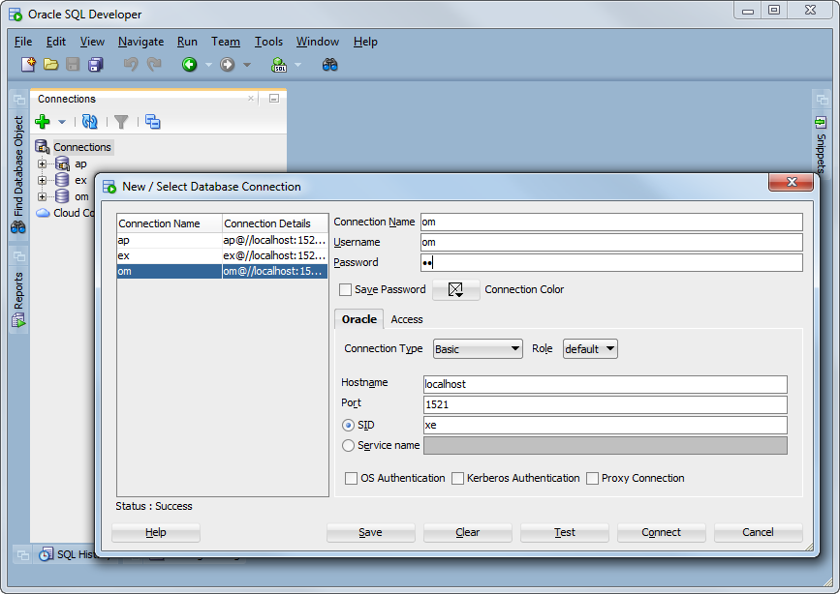
Murach’s Oracle SQL and PL/SQL, C2
© 2014, Mike Murach & Associates, Inc.
Slide <number>

Slide 12
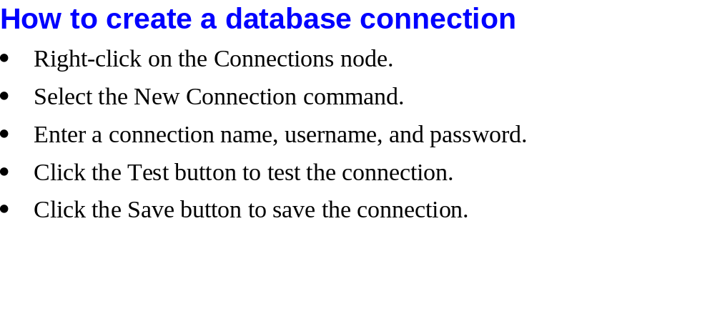
Murach’s Oracle SQL and PL/SQL, C2
© 2014, Mike Murach & Associates, Inc.
Slide <number>

Slide 13
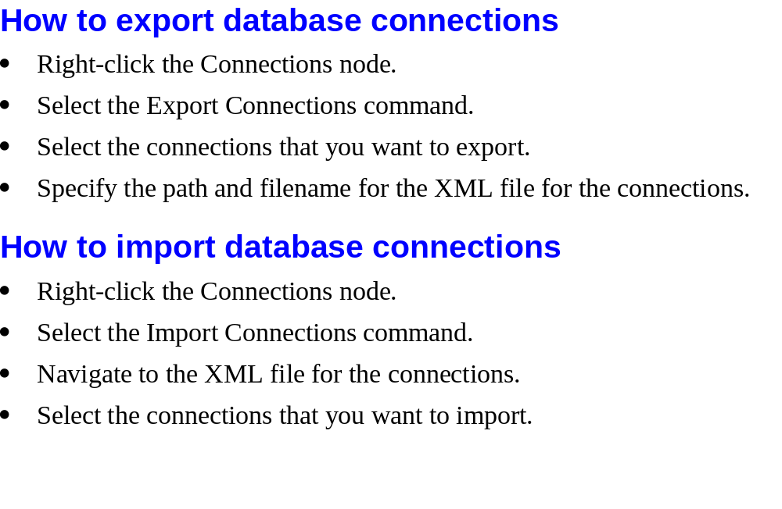
Murach’s Oracle SQL and PL/SQL, C2
© 2014, Mike Murach & Associates, Inc.
Slide <number>

Slide 14

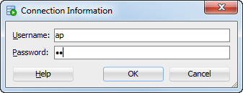
Murach’s Oracle SQL and PL/SQL, C2
© 2014, Mike Murach & Associates, Inc.
Slide <number>

Slide 15
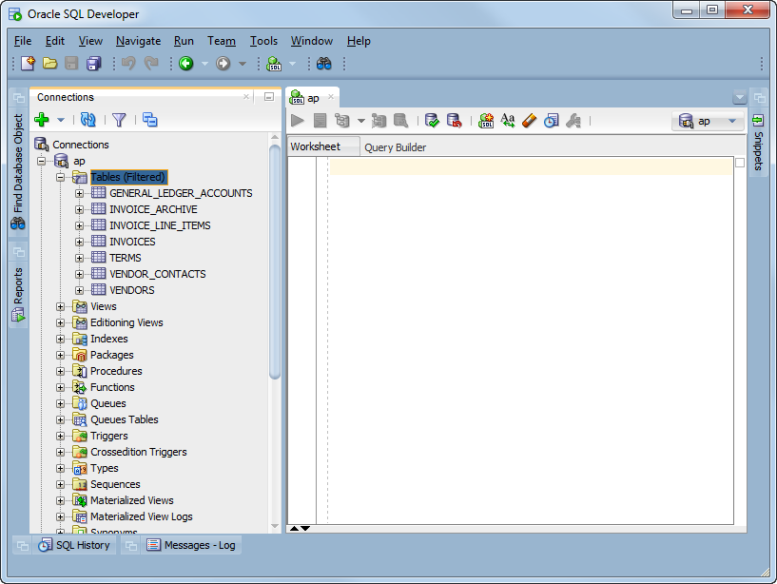
Murach’s Oracle SQL and PL/SQL, C2
© 2014, Mike Murach & Associates, Inc.
Slide <number>

Slide 16
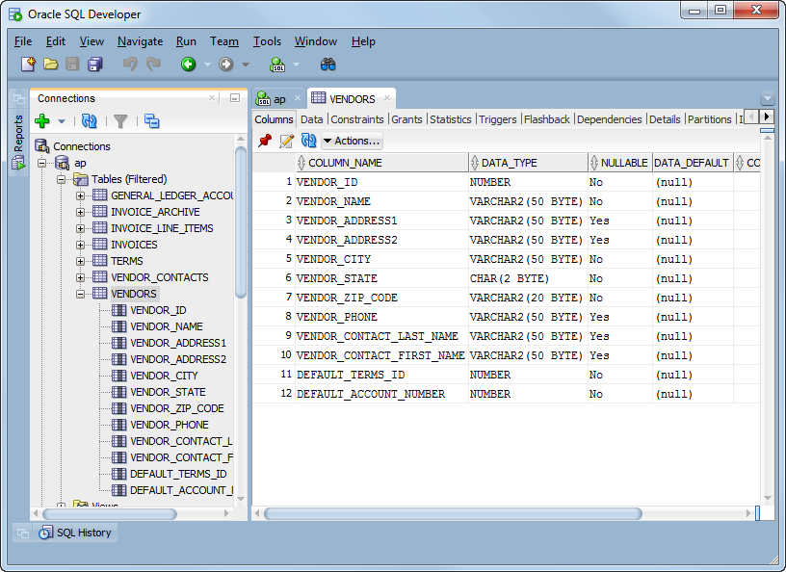
Murach’s Oracle SQL and PL/SQL, C2
© 2014, Mike Murach & Associates, Inc.
Slide <number>

Slide 17
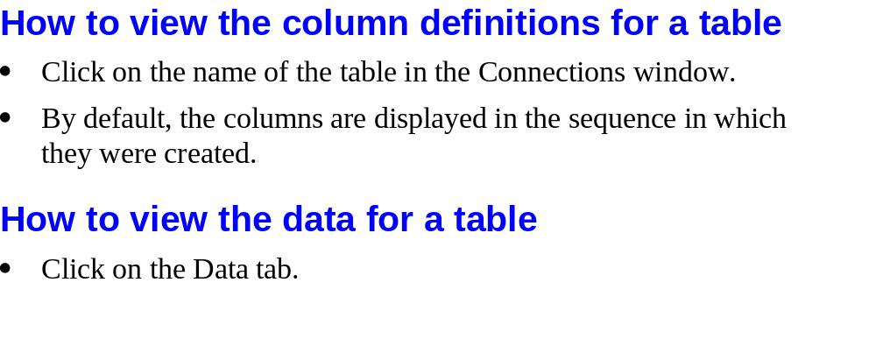
Murach’s Oracle SQL and PL/SQL, C2
© 2014, Mike Murach & Associates, Inc.
Slide <number>

Slide 18

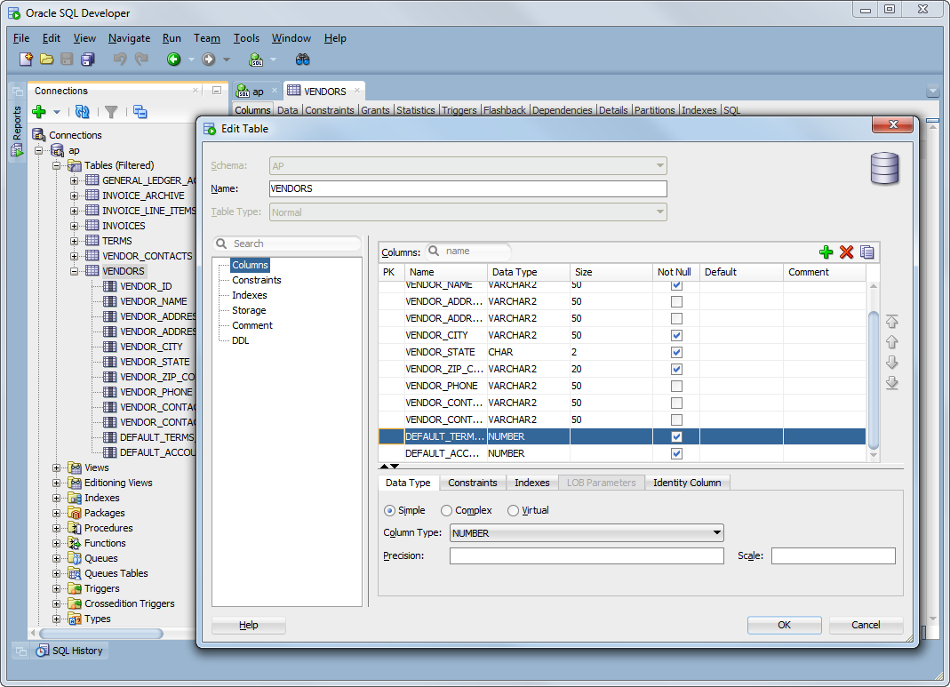
Murach’s Oracle SQL and PL/SQL, C2
© 2014, Mike Murach & Associates, Inc.
Slide <number>

Slide 19

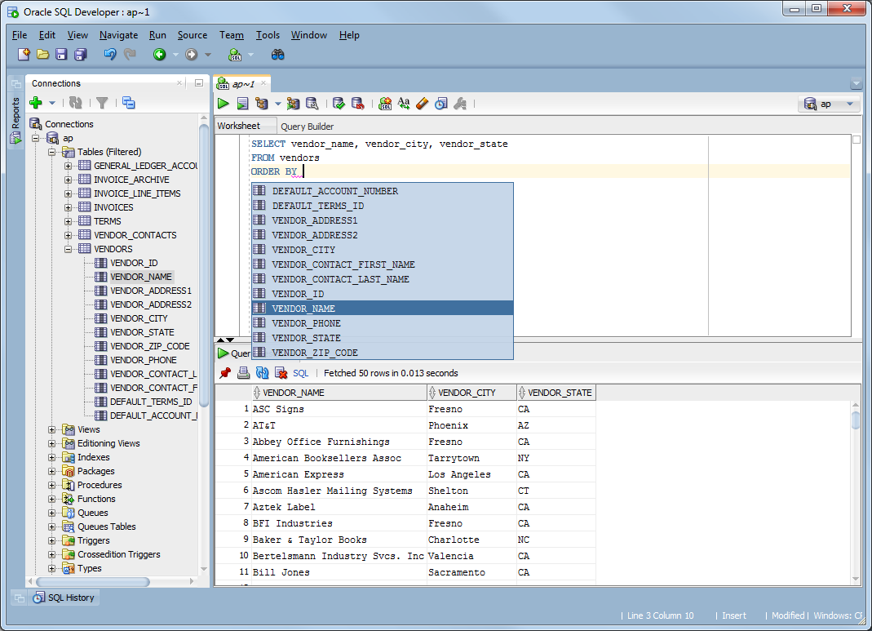
Murach’s Oracle SQL and PL/SQL, C2
© 2014, Mike Murach & Associates, Inc.
Slide <number>

Slide 20
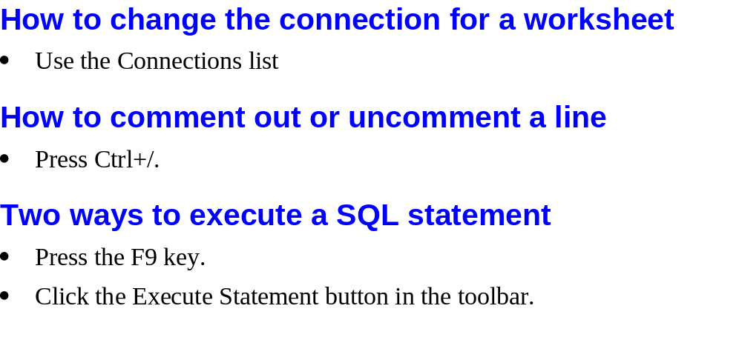
Murach’s Oracle SQL and PL/SQL, C2
© 2014, Mike Murach & Associates, Inc.
Slide <number>

Slide 21

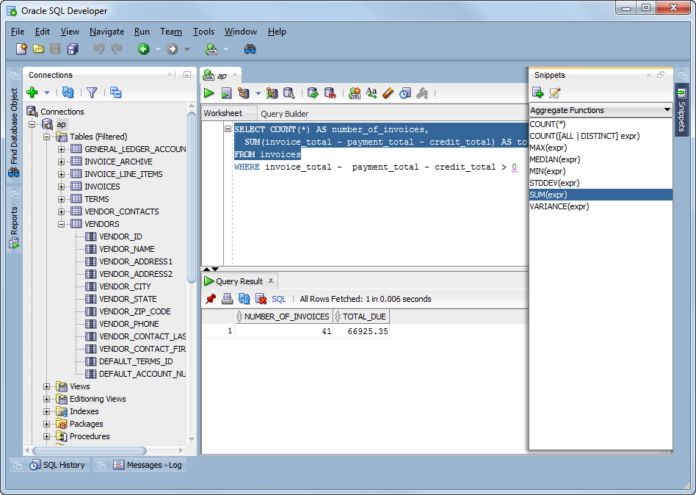
Murach’s Oracle SQL and PL/SQL, C2
© 2014, Mike Murach & Associates, Inc.
Slide <number>

Slide 22

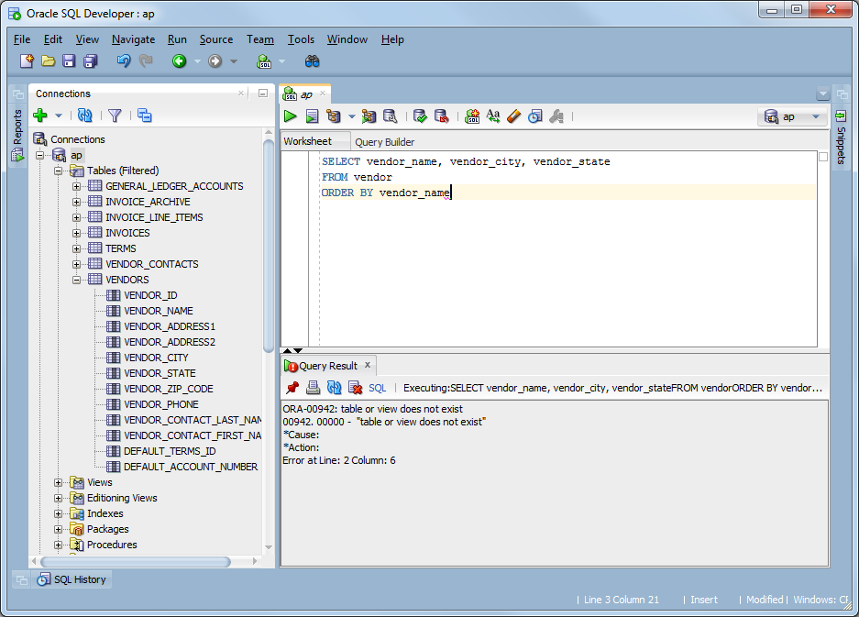
Murach’s Oracle SQL and PL/SQL, C2
© 2014, Mike Murach & Associates, Inc.
Slide <number>

Slide 23
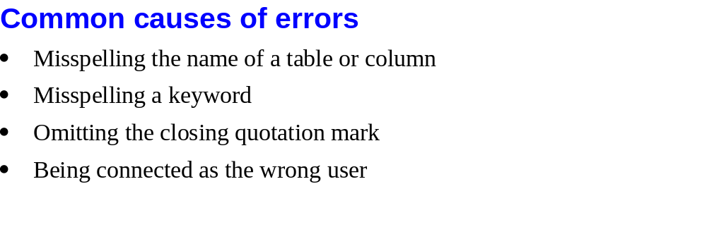
Murach’s Oracle SQL and PL/SQL, C2
© 2014, Mike Murach & Associates, Inc.
Slide <number>

Slide 24

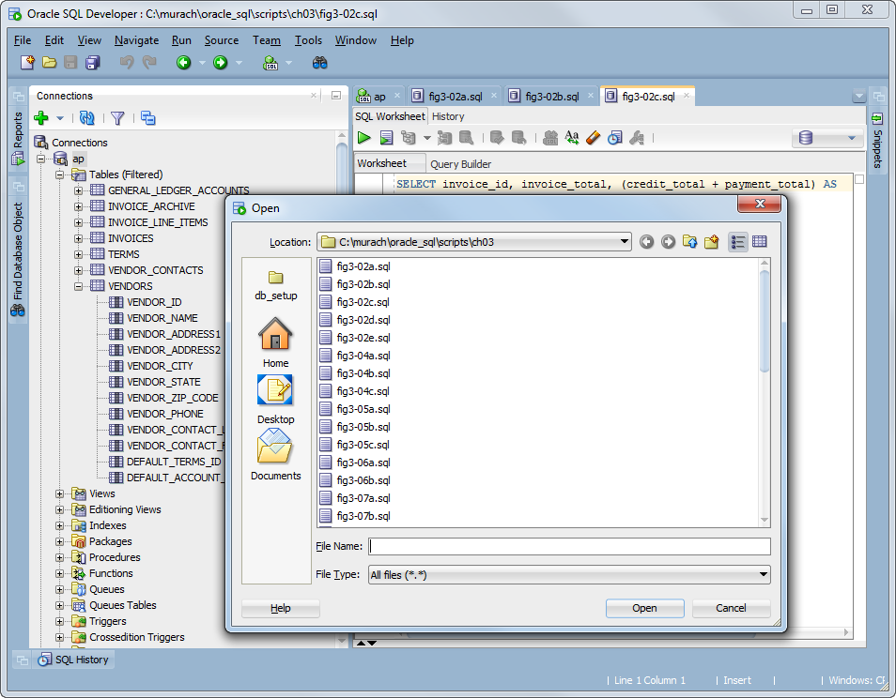
Murach’s Oracle SQL and PL/SQL, C2
© 2014, Mike Murach & Associates, Inc.
Slide <number>

Slide 25
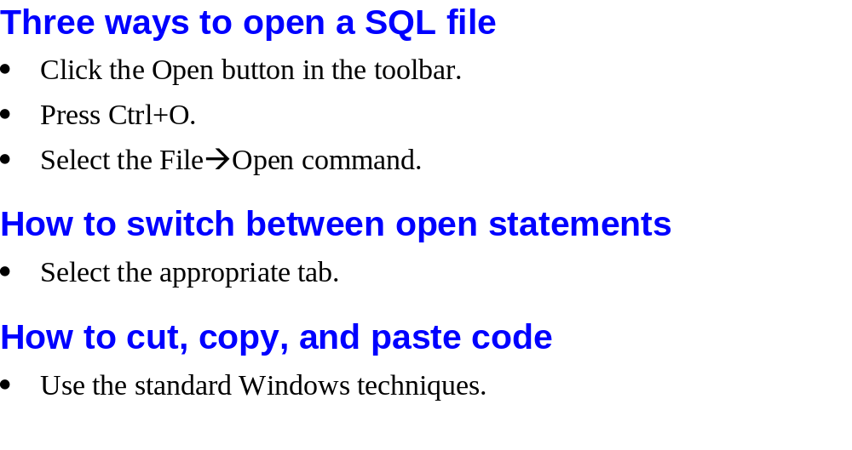
Murach’s Oracle SQL and PL/SQL, C2
© 2014, Mike Murach & Associates, Inc.
Slide <number>

Slide 26
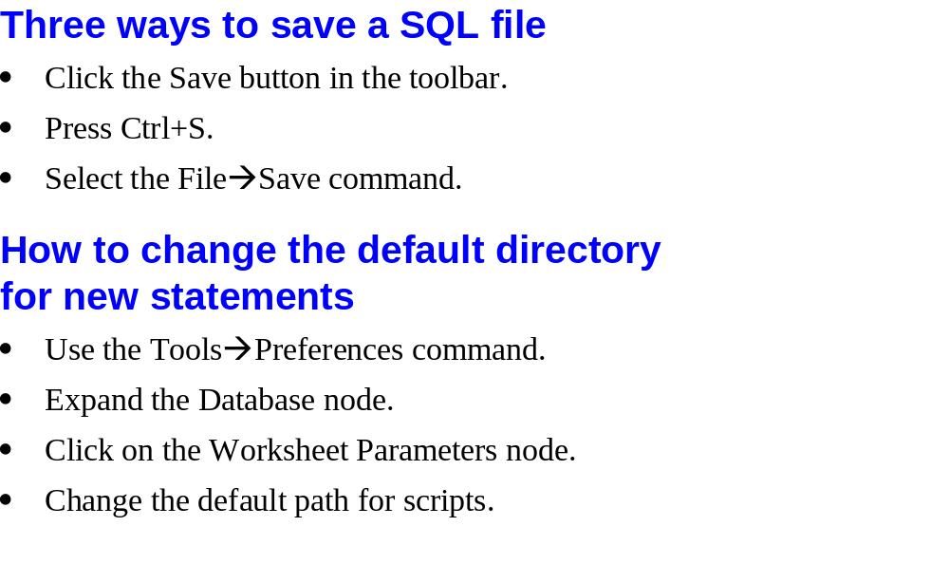
Murach’s Oracle SQL and PL/SQL, C2
© 2014, Mike Murach & Associates, Inc.
Slide <number>

Slide 27

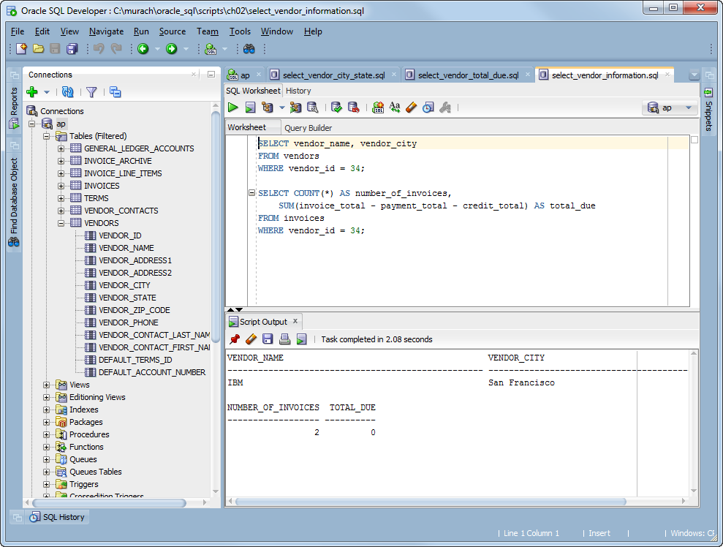
Murach’s Oracle SQL and PL/SQL, C2
© 2014, Mike Murach & Associates, Inc.
Slide <number>

Slide 28
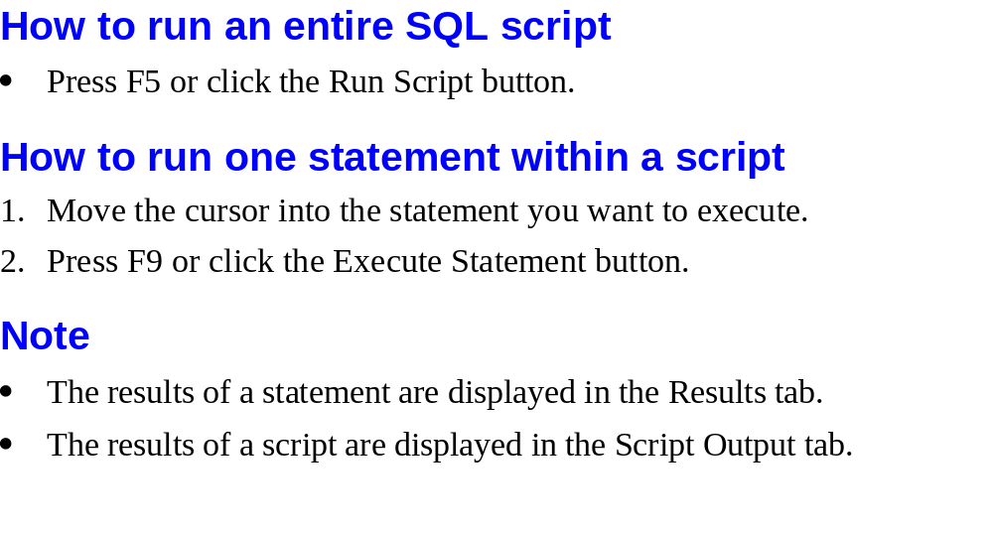
Murach’s Oracle SQL and PL/SQL, C2
© 2014, Mike Murach & Associates, Inc.
Slide <number>

Slide 29

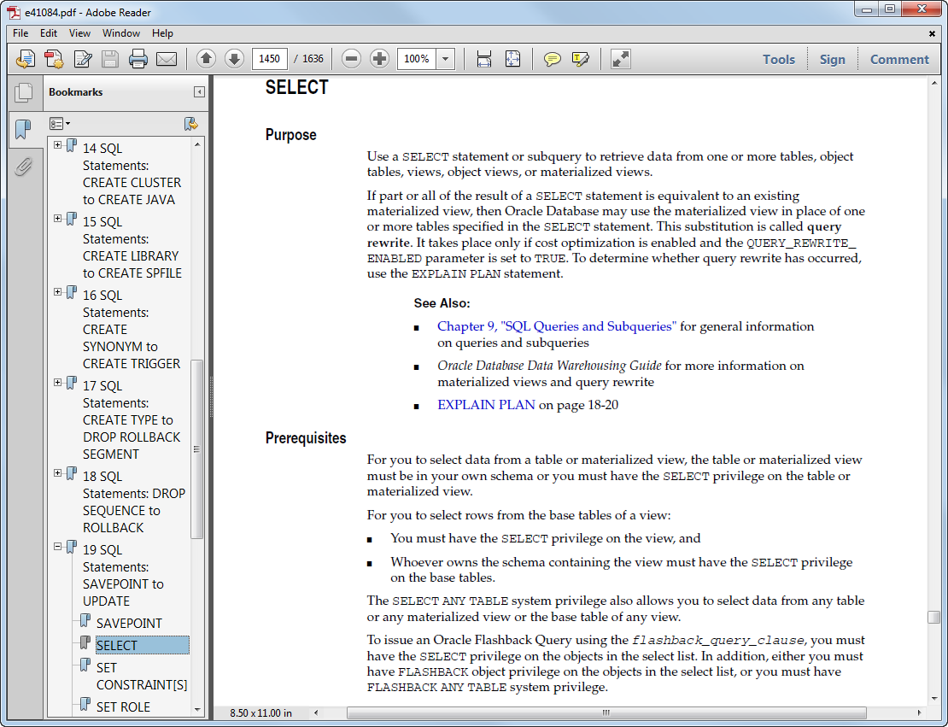
Murach’s Oracle SQL and PL/SQL, C2
© 2014, Mike Murach & Associates, Inc.
Slide <number>

